Slide 1
N-15 Muon Lifetime
PHYS 4410 - Experiment
David Thuman

Slide 2
Goal of Experiment
To experimental measure the lifetime of a muon
Techniques of particle detection
Calibration of equipment
Statistical analysis of data

Slide 3
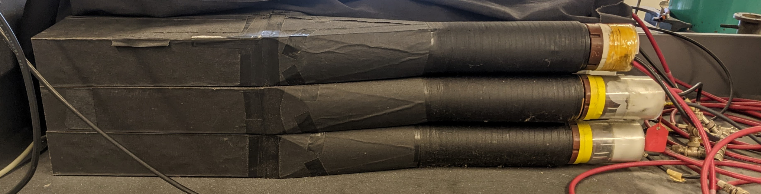
Registering Muon Pulses
Scintillator
Photomultiplier Tube (PMT)

Slide 4
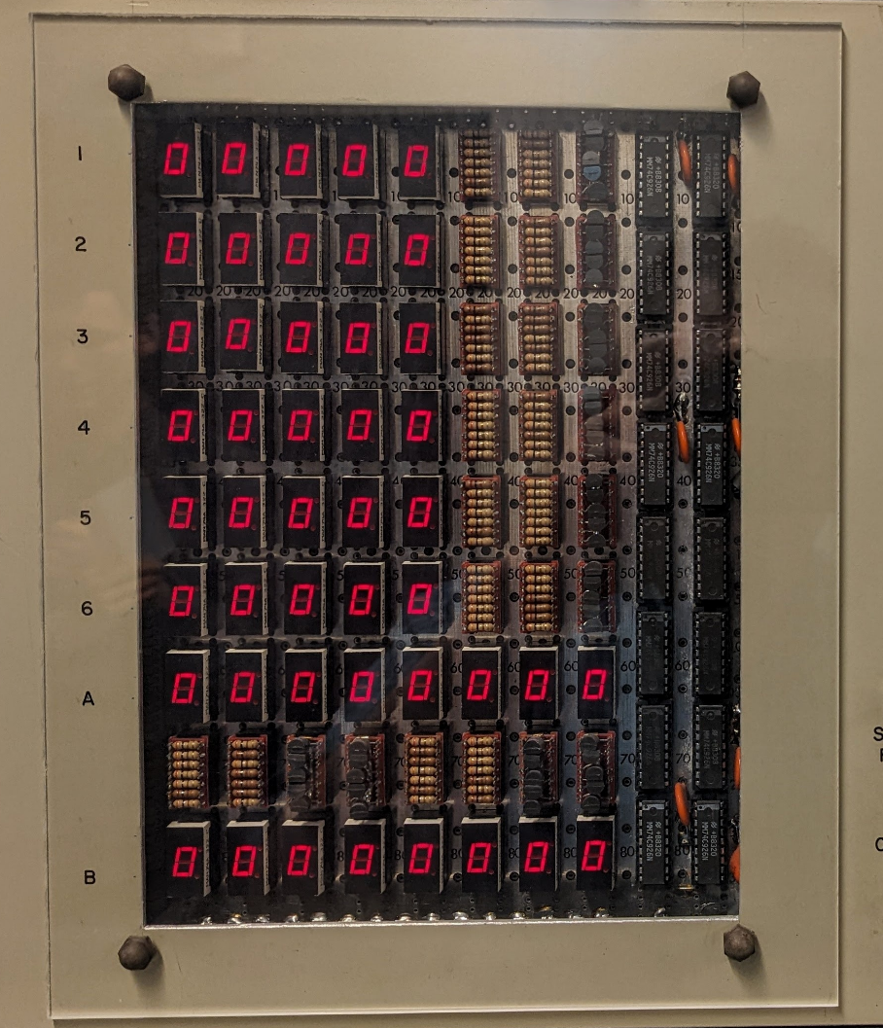
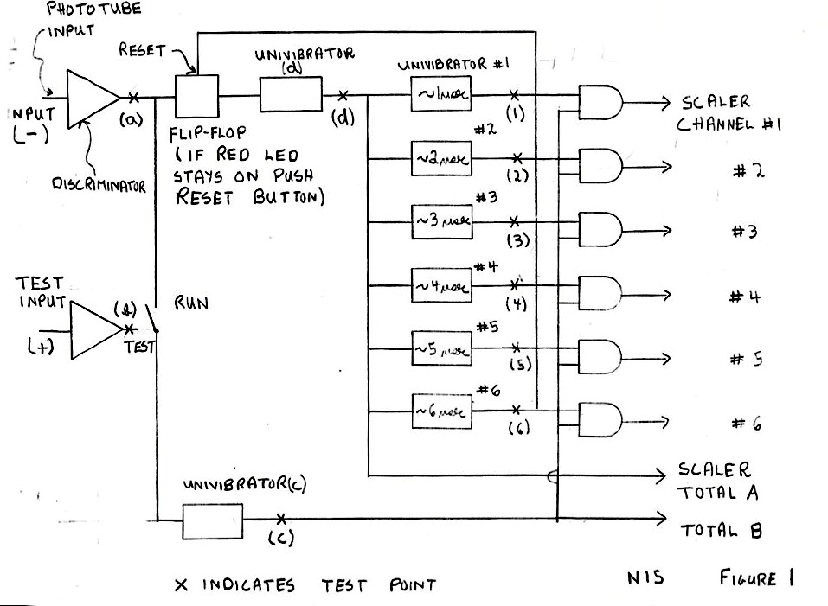
Counter and Counter Circuit
Left Figure: Counter display
Right Figure: Counter Block diagram

Slide 5
Counting the Muons
Univibrator | Time Delay | Pulse Width
D | Faction of μsecond | unknown
C | < D | unknown
1 | unknown | ~ 1 μsecond
2 | unknown | ~ 2 μsecond
Univibrator D
Univibrator 1
Scalar Channel 1
Discriminator
D Flip-Flop
Univibrator 2
Scalar Channel 2
Univibrator C

Slide 6
Counting the Muons
Univibrator | Time Delay | Pulse Width
D | Faction of μsecond | unknown
C | < D | unknown
1 | unknown | ~ 1 μsecond
2 | unknown | ~ 2 μsecond
Univibrator D
Univibrator 1
Scalar Channel 1
Discriminator
D Flip-Flop
Univibrator 2
Scalar Channel 2
Univibrator C

Slide 7
Counting the Muons
Univibrator | Time Delay | Pulse Width
D | Faction of μsecond | unknown
C | < D | unknown
1 | unknown | ~ 1 μsecond
2 | unknown | ~ 2 μsecond
Univibrator D
Univibrator 1
Scalar Channel 1
Discriminator
D Flip-Flop
Univibrator 2
Scalar Channel 2
Univibrator C

Slide 8
Counting the Muons
Univibrator | Time Delay | Pulse Width
D | Faction of μsecond | unknown
C | < D | unknown
1 | unknown | ~ 1 μsecond
2 | unknown | ~ 2 μsecond
Univibrator D
Univibrator 1
Scalar Channel 1
Discriminator
D Flip-Flop
Univibrator 2
Scalar Channel 2
Univibrator C

Slide 9
Counting the Muons
Univibrator | Time Delay | Pulse Width
D | Faction of μsecond | unknown
C | < D | unknown
1 | unknown | ~ 1 μsecond
2 | unknown | ~ 2 μsecond
Univibrator D
Univibrator 1
Scalar Channel 1
Discriminator
D Flip-Flop
Univibrator 2
Scalar Channel 2
Univibrator C

Slide 10
Counting the Muons
Univibrator | Time Delay | Pulse Width
D | Faction of μsecond | unknown
C | < D | unknown
1 | unknown | ~ 1 μsecond
2 | unknown | ~ 2 μsecond
Univibrator D
Univibrator 1
Scalar Channel 1
Discriminator
D Flip-Flop
Univibrator 2
Scalar Channel 2
Univibrator C

Slide 11
Counting the Muons
Univibrator | Time Delay | Pulse Width
D | Faction of μsecond | unknown
C | < D | unknown
1 | unknown | ~ 1 μsecond
2 | unknown | ~ 2 μsecond
Univibrator D
Univibrator 1
Scalar Channel 1
Discriminator
D Flip-Flop
Univibrator 2
Scalar Channel 2
Univibrator C

Slide 12
Counting the Muons
Univibrator | Time Delay | Pulse Width
D | Faction of μsecond | unknown
C | < D | unknown
1 | unknown | ~ 1 μsecond
2 | unknown | ~ 2 μsecond
Univibrator D
Univibrator 1
Scalar Channel 1
Discriminator
D Flip-Flop
Univibrator 2
Scalar Channel 2
Univibrator C

Slide 13
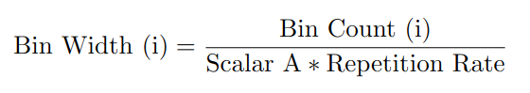
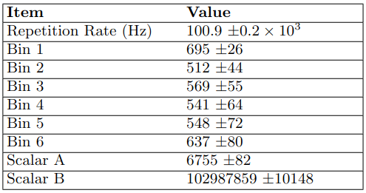
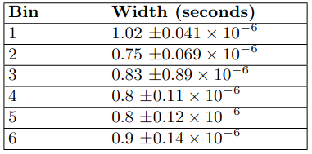
Calculating Bin Width

Slide 14
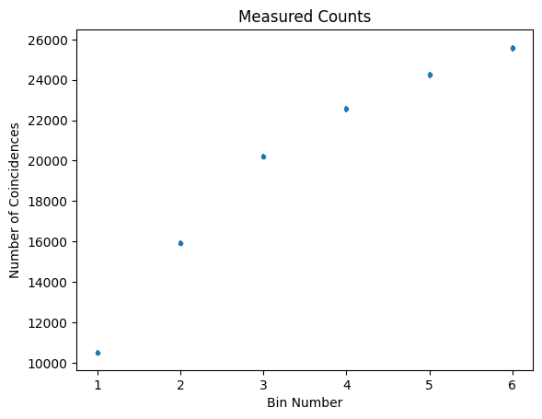
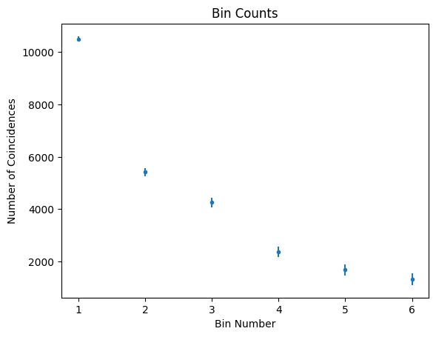
Fitting Observed Data

Slide 15
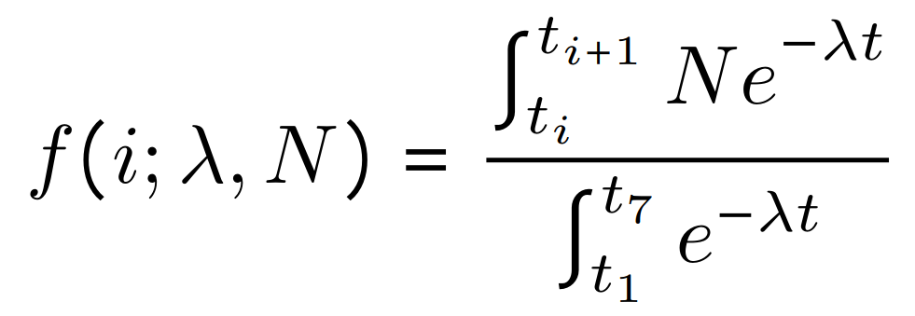
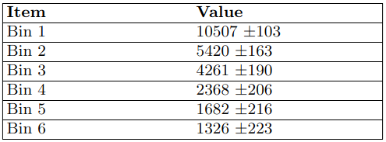
Function to Fit Data
i is the Bin number
t_{i} is the start time of Bin i
t_{i+1} is the end time of Bin i (or the start time of Bin i+1
N is the total number of observations
𝜆 is the inverse muon decay rate

Slide 16
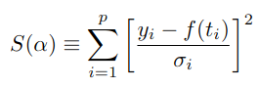
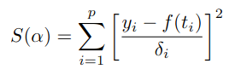
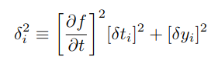
Uncertainty Analysis - Least Squares
Least Squares Optimizer
for δt_{i} = 0
Least Squares Optimizer
for δt_{i} ≠ 0

Slide 17
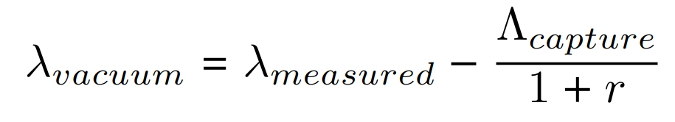
Negative Muon Capture
However, the apparatus captures both negative and positive muons
Negative muons have a slightly shorter decay time
Using
Ratio of positive to negative muons: r = 1.18 ± 0.12
Capture rate in carbon: 𝛬_{caputre} = 3.76 ± 0.04 * 10⁴ Hz

Slide 18
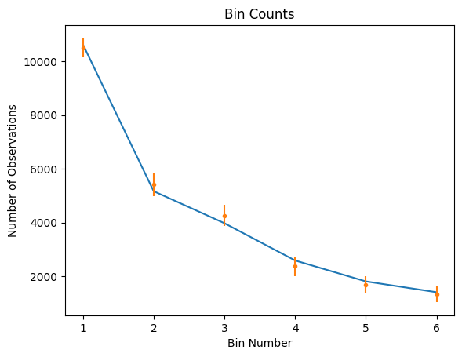
Results
Uncertainty Corrected Least Squares
2.15 ± 0.062 * 10⁻⁶ seconds
Negation Muon Correction
2.23 ± 0.068 * 10⁻⁶ seconds
Accepted Value
2.19703 ± 0.00004 * 10⁻⁶ seconds

